Slide 1
Wearing Mask Detection System
Fityanul Akhyar PhD (cand)
School of Electrical Engineering
Telkom University - Indonesia

Slide 2
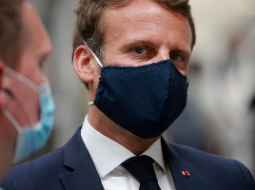
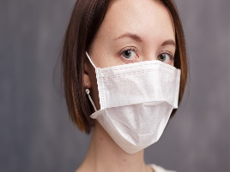
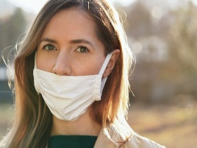
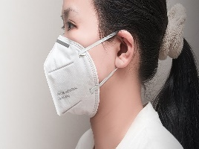
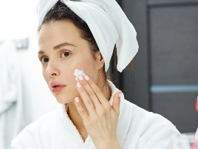
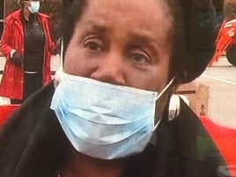
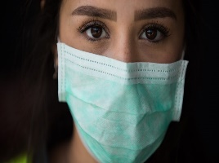
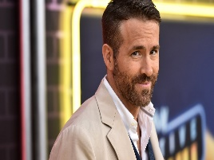
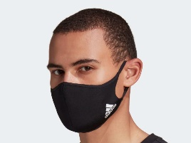
INTRODUCTION
Examples of RGB Image
Due to the COVID-19 pandemic, wearing a mask is mandatory in public spaces, as properly wearing a mask offers a maximum preventive effect against viral transmission.
In this work, we need to design a real-time deep learning model to meet current demand to detect the mask-wearing position of a person before he or she enters a public space. In this experiment, we need to use a deep learning object detection method to create a mask position detector with the dataset in page 5.
See demo video file for the example.

Slide 3
METHODOLOGY
Object Detection
(Regression)
Face Detection
Face with Mask
Face without Mask

Slide 4
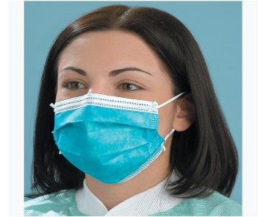
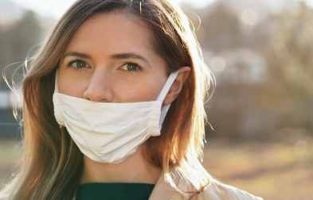
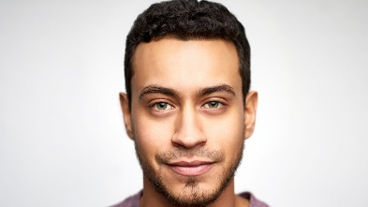
METHODOLOGY
STEP 2:
Object Classification
Mask Wearing Position
bad
good
none

Slide 5
DATASET & DEMO
Link for experiment dataset:
https://www.kaggle.com/shreyashwaghe/medical-mask-dataset
Link for demo video:
https://drive.google.com/file/d/1S_jYh4Vc_lCRDuiHL46PJ-v_9pXVG2i9/view?usp=sharing
Notes:
Sample of the failed detected images from Module 1 and Module 2. In A, C) our model gives two high confidence scores for different classes. In B, D) Module 2 fails to detect the different quality images from another output camera.

Slide 6
Thank You

